Slide 1



Traffic Accident Patterns Analysis
Submitted By:
Veera Teja Shesha Sai Viswanadh - 22A31A04S9
Puppala Sri Vinay - 22A31A43G7
Under the guidance of:
K . Narmada Mani
V . Vanitha

Slide 2


CONTENTS
Abstract
Introduction
System Requirements
Architecture
Uses of data analysis library
Advantages
Conclusion

Slide 3
ABSTRACT
This project aims to explore traffic accident patterns through detailed data analysis using Python in Jupyter Notebook. Traffic accidents are a critical global issue, resulting in loss of life, injuries, and economic burdens.
The final goal is to present actionable insights and raise awareness using interactive graphs and findings derived from real-world data. By using Jupyter Notebook, the project ensures reproducibility, transparency, and an educational approach.

Slide 4
INTRODUCTION
Analyze global traffic accident data to uncover trends, causes, and risk factors using data science tools for improving road safety and urban mobility.
Utilizes Python libraries Pandas and Matplotlib on the "global_traffic_accidents.csv" dataset sourced from Kaggle.
Analysis Performed:
Data cleaning and transformation, Temporal (daily/monthly) trends,
Geographic hotspots, Impact of weather, road conditions, and vehicle
involvement
Delivers actionable insights through visualizations to aid planners, engineers, and policy-makers in reducing accidents and enhancing transportation safety.

Slide 5
SYSTEM REQUIREMENTS
OPERATING SYSTEM:
The analysis can be performed on Windows .
Python:
Python 3.x is required for running the analysis.
Libraries:
1. Pandas: Install the Pandas library using pip, a package manager for Python.
Pip install pandas

Slide 6
SYSTEM REQUIREMENTS
2. Matplotlib: Install the Matplotlib library using pip as well
pip install matplotlib
3. Seaborn: Install the seaborn library using pip command
Pip install seaborn
3
HARDWARE REQUIREMNTS :
IDE – Jupyter Notebook
Storage Space – free storage space enough for running on machine

Slide 7
ARCHITECTURE
The architecture of the hotel booking analysis using Python, Matplotlib, and Pandas involves several key steps that form a cohesive workflow.
The process typically includes data acquisition, data preprocessing, data visualization.
Let's explore the architecture in more details:
IMPORTING DATASET, DATA EXPLORATION, DATA CLEANING, DATA
GROUPING and DATA VISUALISATION.

Slide 8

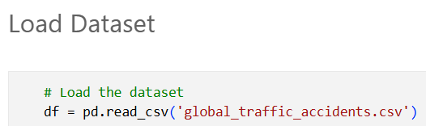
IMPORTING DATASET:
The project begins with data collection, where the global_traffic_accidents Dataset is sourced from reliable repositories or research databases. The dataset is then loaded into the Python environment using the Pandas library, creating a structured DataFrame for efficient data handling.

Slide 9
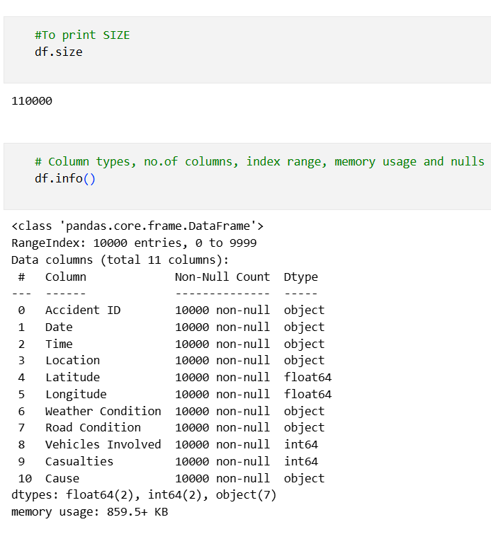
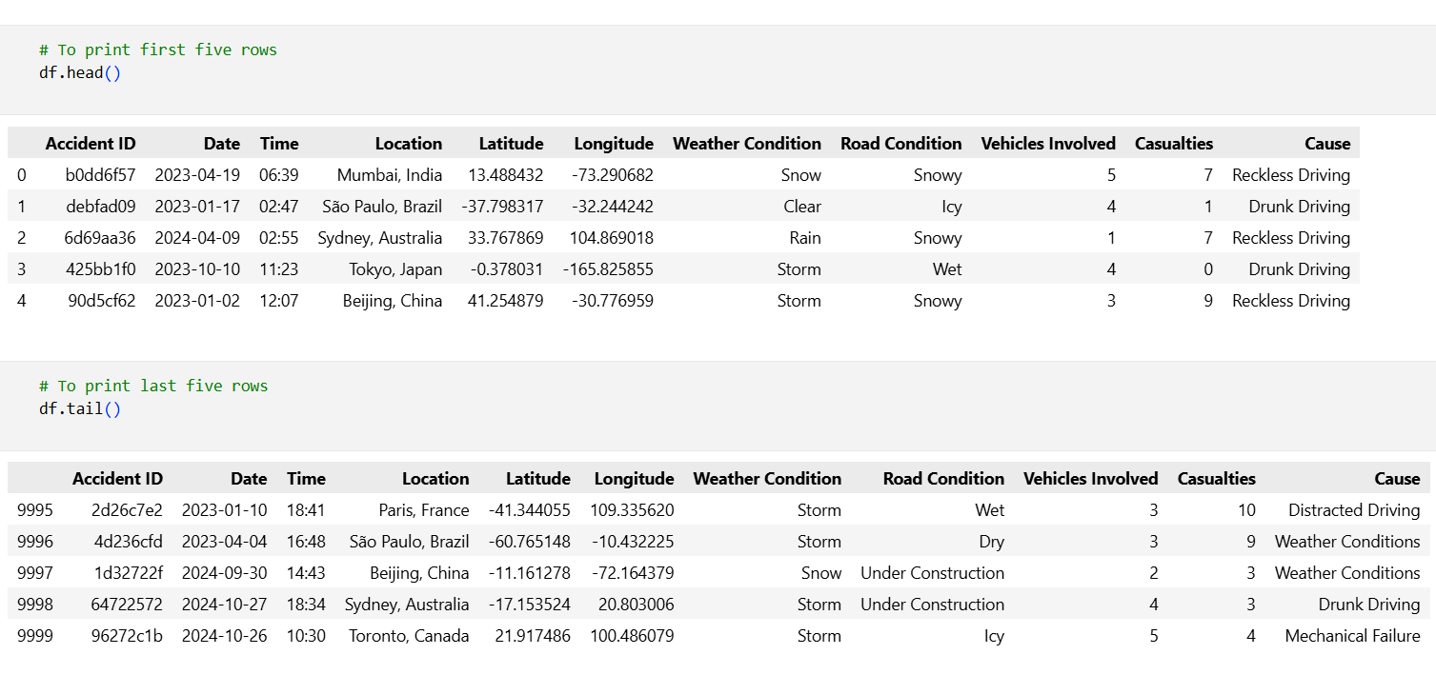
DATA EXPLORATION
The data exploration phase involves examining the dataset's basic structure, using Pandas functions like head(), info(), and describe() to gain initial insights.

Slide 10
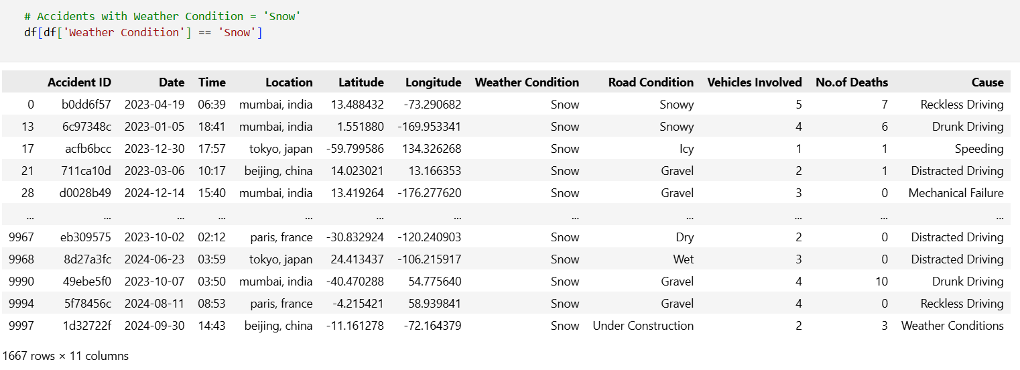
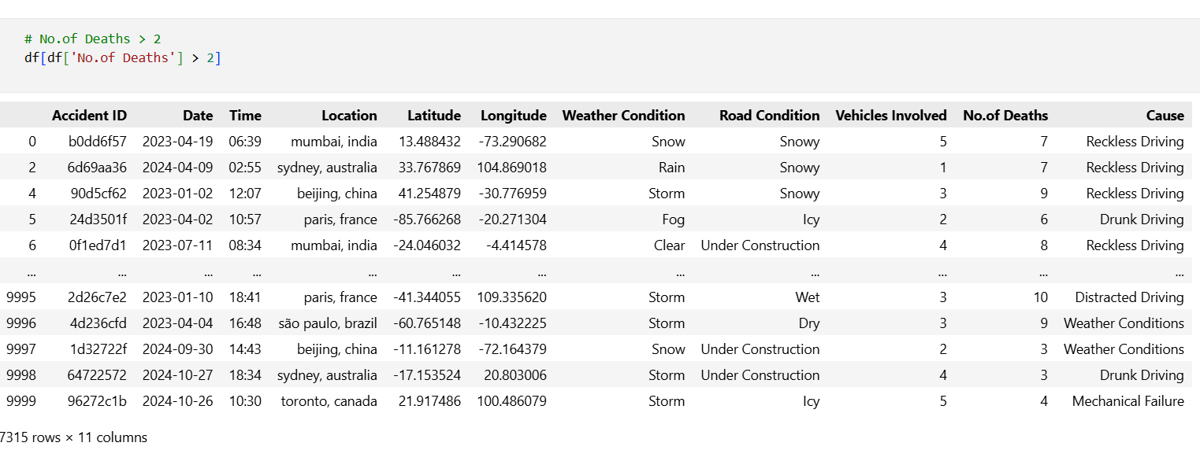
DATA EXPLORATION:
Data cleaning is performed to handle missing values, duplicates, and irrelevant columns, ensuring the dataset is ready for analysis. Any inconsistencies or data quality issues are addressed during this stage.

Slide 11
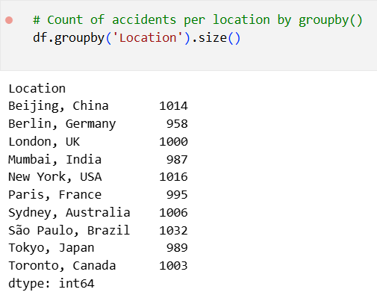
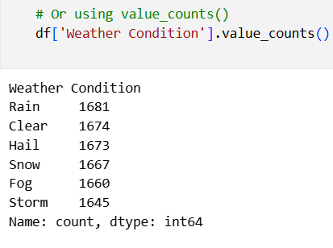
DATA GROUPING:
In this project, grouping operation IS extensively used to uncover meaningful patterns from the traffic accident dataset. These techniques enable us to slice the data based on key attributes such as location, date, weather conditions, cause of accident, and number of vehicles involved, allowing for deeper insights into accident behavior and trends.

Slide 12
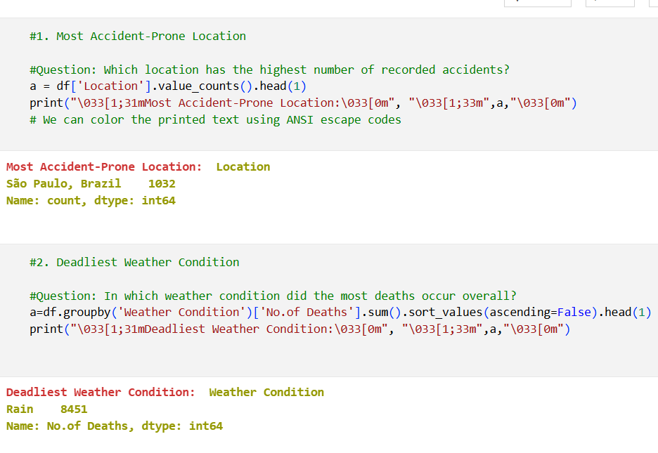
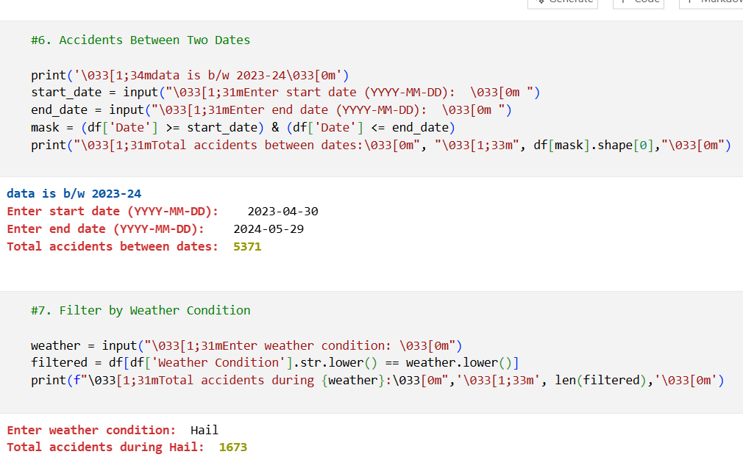
QUERIES:

Slide 13
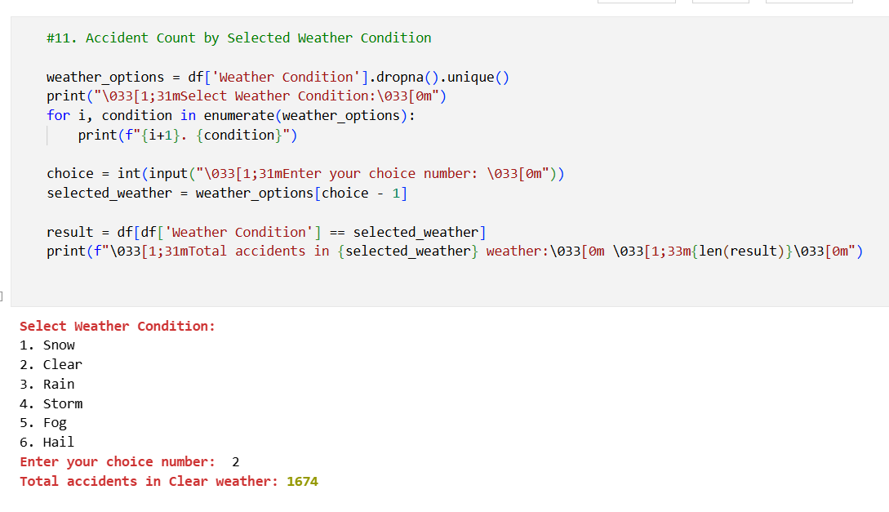
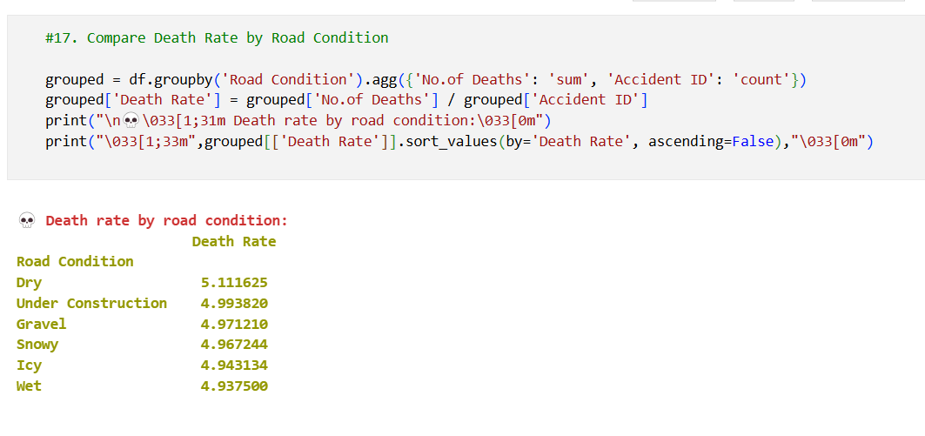
QUERIES:

Slide 14
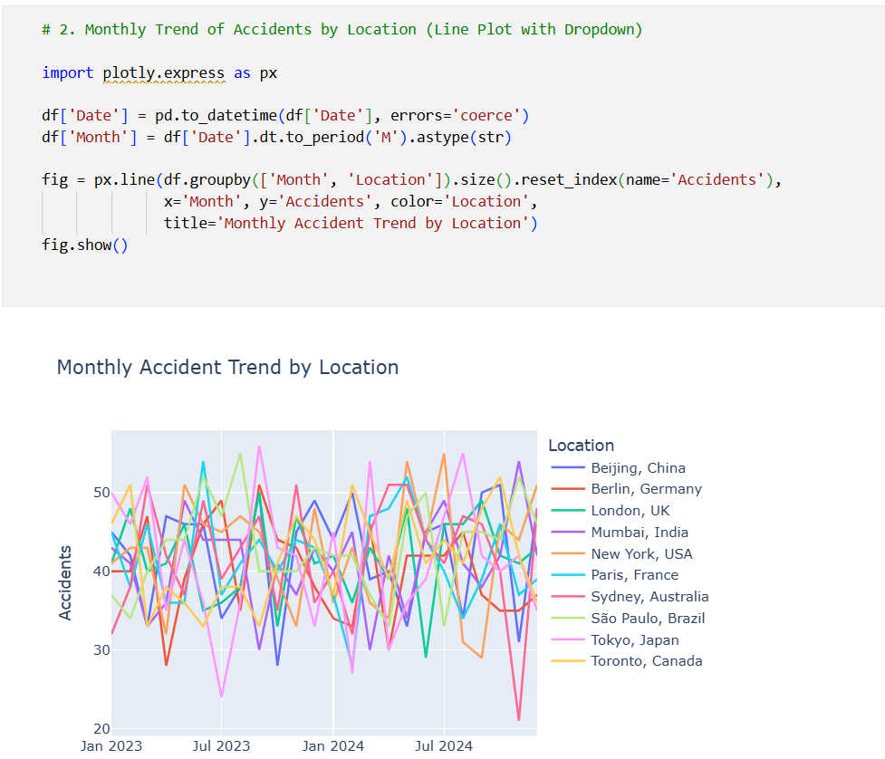
DATA VISUALISATION:
To effectively communicate the results of the traffic accident analysis, Matplotlib and Seaborn are employed to generate informative and visually engaging visualizations. A variety of plot types—including scatter plots, bar charts, box plots, and heatmaps—are utilized to illustrate relationships, trends, and distributions among key dataset attributes such as accident location, weather conditions, number of vehicles involved, and causes. These visual tools play a critical role in helping uncover hidden patterns, compare categorical variables, and support data-driven decision-making by making complex data more accessible and interpretable.

Slide 15
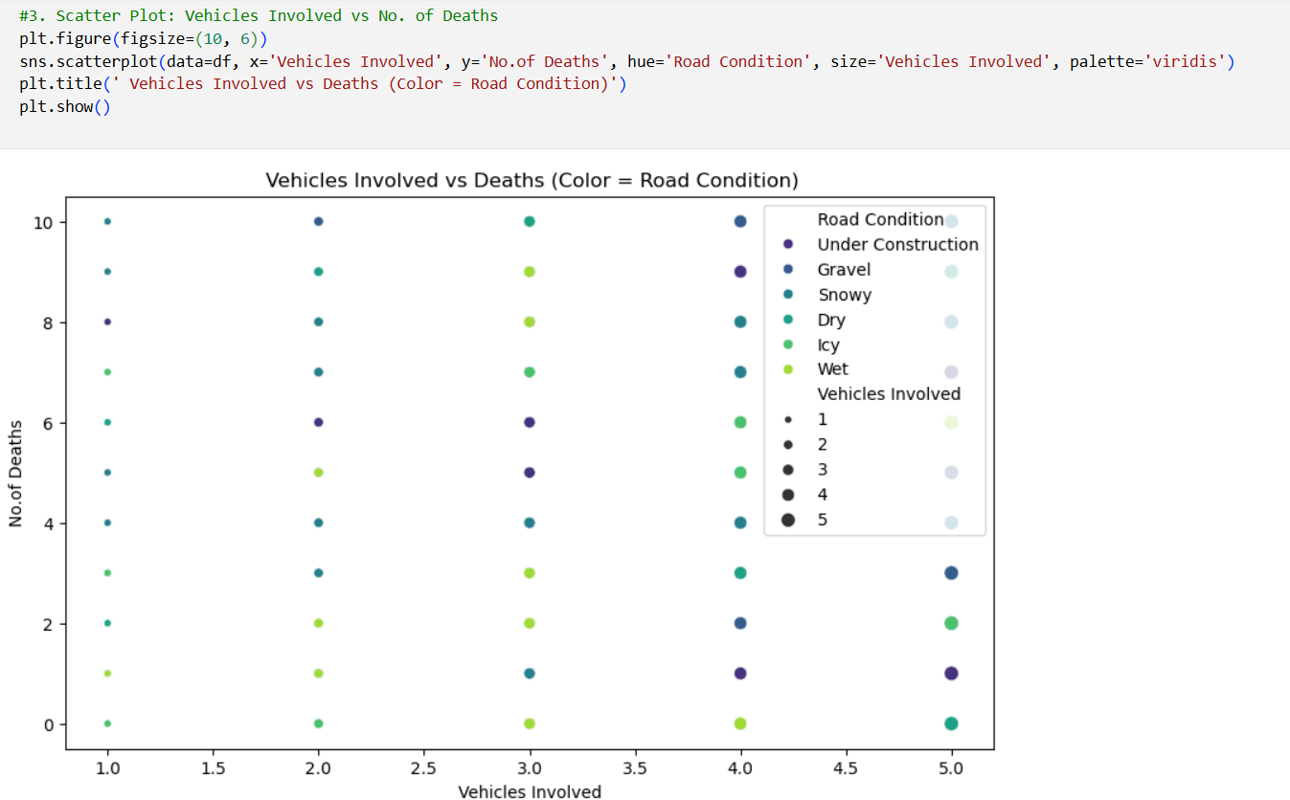
DATA VISUALISATION:

Slide 16
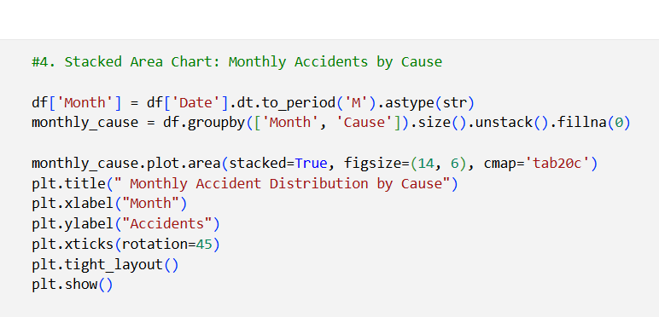
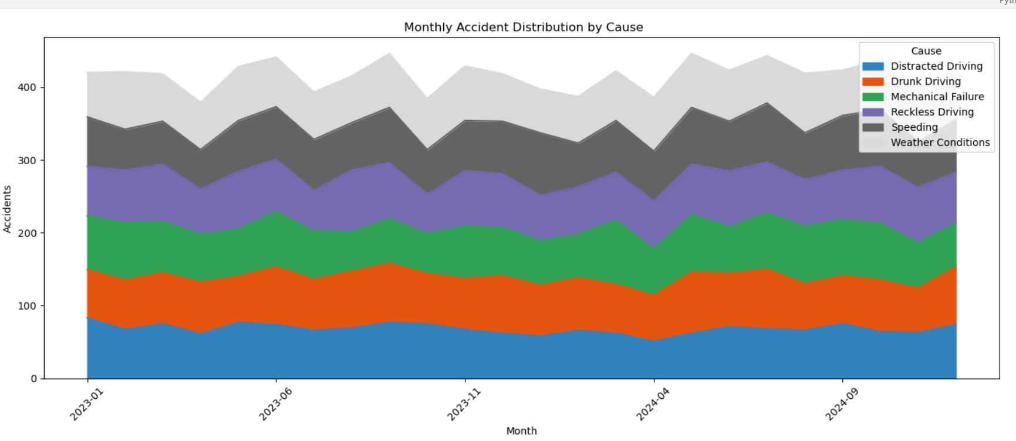
DATA VISUALISATION:

Slide 17
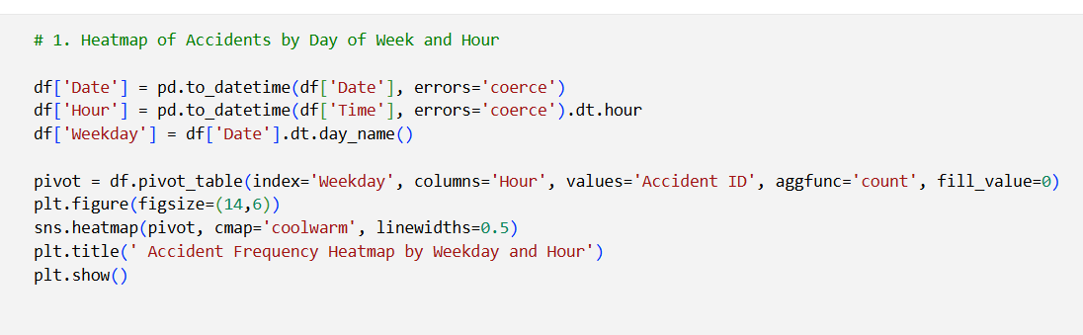
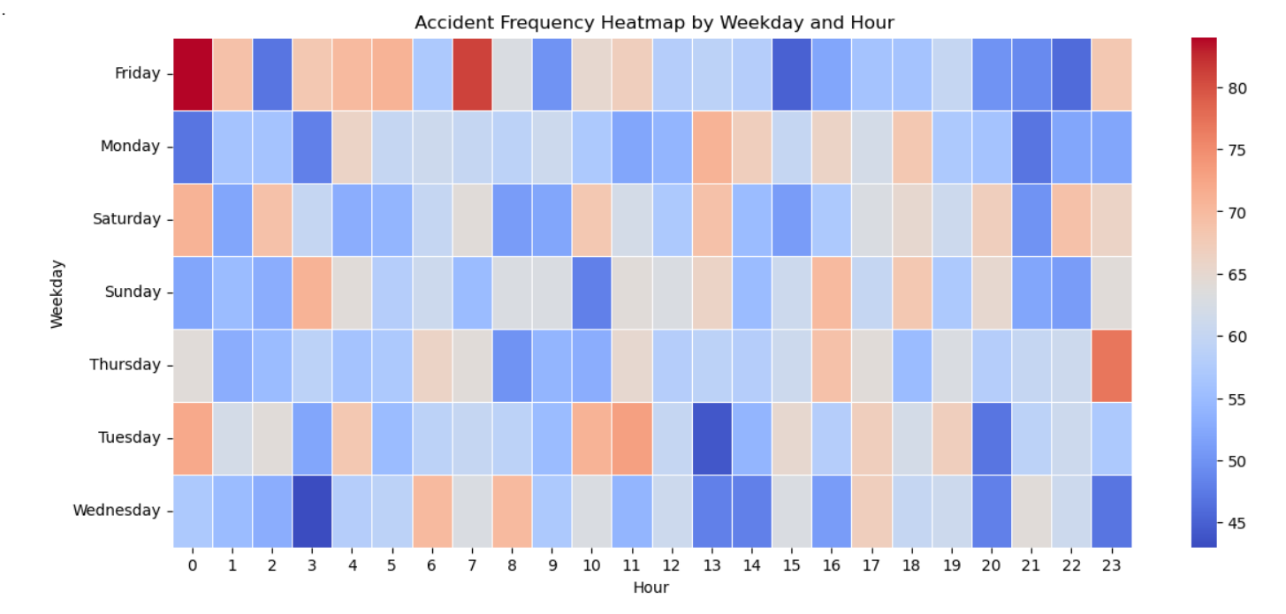
DATA VISUALISATION:

Slide 18
DATA ANALYSIS LIBRARY
PANDAS: Data Manipulation:. It allows filtering, grouping, and aggregating data to derive meaningful insights. Handling Missing Data: Pandas' functions handle missing data points effectively, ensuring data quality and preventing biases in the analysis. Joining and Merging: Pandas is used to combine datasets when additional information, such as customer reviews or hotel amenities, is available separately.
MATPLOTLIB: Data Visualization: Matplotlib allows the creation of various visualizations like line plots, bar charts, and scatter plots to depict booking trends, revenue fluctuations, and customer distribution. Time Series Analysis: With Matplotlib, time series plots can illustrate booking patterns over specific time intervals, highlighting seasonal variations and trends.
SEABORN : Enhanced Data Visualization: Seaborn is built on top of Matplotlib and offers more aesthetically pleasing and informative visualizations. It simplifies the creation of complex plots like heatmaps, pair plots, and violin plots. Categorical Data Visualization: It excels at visualizing categorical data, such as room types or customer nationalities, using bar plots or box plots, which aids in understanding preferences and trends.

Slide 19
ADVANTAGES:
Versatility and Flexibility:
Python, as a programming language, is highly versatile and flexible, allowing easy integration with various data sources and formats. This enables hoteliers to analyze data from different booking platforms and internal databases seamlessly.
Rich Data Analysis Libraries:
Pandas, Matplotlib, and Seaborn provide a comprehensive suite of data manipulation, visualization, and statistical functions. Their extensive capabilities empower analysts to perform complex data analysis and generate informative visualizations with relative ease.
Data Visualization:
Matplotlib and Seaborn excel at creating visually appealing and informative plots, charts, and graphs. These visualizations enhance the presentation of complex data, making it easier for stakeholders to understand trends, patterns, and correlations.
Data-Driven Decision Making:
By analyzing booking patterns, customer preferences, and revenue trends, hotel management can make data-driven decisions to optimize pricing, marketing strategies, and operational efficiency. This leads to better resource allocation and improved customer experiences.

Slide 20
REFERENCES:
Pandas Documentation
https://pandas.pydata.org/docs/
NumPy Documentation
https://numpy.org/doc/
Matplotlib Documentation
https://matplotlib.org/stable/contents.html
Seaborn Documentation
https://seaborn.pydata.org/
Python Official Documentation
https://docs.python.org/3/

Slide 21
REFERENCES:
Traffic Accident Dataset Source (if from Kaggle or any public dataset)
https://www.kaggle.com/datasets/adilshamim8/global-traffic-accidents-dataset
Jupyter Notebook Documentation
https://jupyter-notebook.readthedocs.io/en/stable/
Github Repository Link
https://github.com/VISWANADHVEERA/traffic-accident-patterns

Slide 22
Conclusion
In conclusion, the Traffic Accident Patterns Analysis using tools such as Python, Pandas, Matplotlib, and Seaborn has successfully uncovered critical insights into the causes, frequency, and distribution of road accidents. Through systematic grouping, filtering, and visualization, this project identifies high-risk locations, recurring accident causes, and the influence of weather and road conditions on accident severity.
The analysis equips policymakers, traffic authorities, and urban planners with actionable data-driven insights to design targeted interventions, improve road safety measures, and allocate resources more effectively. Integrating such data analytics into traffic management systems can serve as a catalyst for enhancing public safety, reducing fatalities, and driving sustainable improvements in urban transportation infrastructure.

Slide 23

Thank You

